Slide 1

Purchasing Intention Prediction
Mentor –
Ms. Vrushali sarwan
PRESENTED BY –
Girish patil

Slide 2
INTRODUCTIONduction
↘ E-commerce, the activity of buying and selling products online, is one of the many fields
revolutionized by data science.
↘ One of the essential goals for e-commerce companies is to increase purchase conversion rates,
i.e. the percentage of website visitors who complete the purchase at online stores.
↘ To achieve this goal, e-commerce companies as well as researchers in academia have devoted efforts in analyzing and modelling the behaviors of webpage users.
↘ Especially in recent year, there has been a trend in research to use machine learning methods to
predict the behavior of users.
Deep Learning Model
Business Insights
User Data

Slide 3
OBJECTIVE
Our overall objective is to analyze the given data and predict/put forward a reasonable action plan for the company which it can employ around its marketing strategies so that to increase number of online visitors complete their purchase successfully.
This will result in increased revenue generation and greater market share for the company.
Predict Shoppers’ Intention to complete
transaction.
Classify user according to there behavior as revenue generating and non-revenue generating.
STEPS

Slide 4
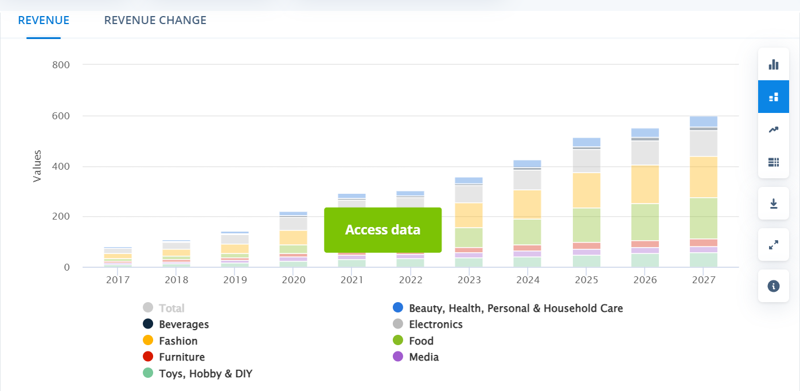
WHY?

Slide 5
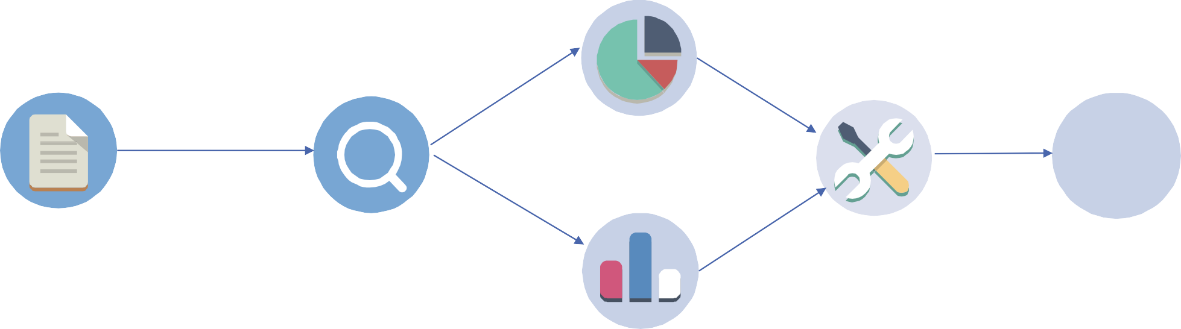
OVERALL APPROACH
Exploratory data analysis
DATA gathering
Deep Learning Techniques
Insight & Recommendation
$
online_shoppers_intention.csv
Total records: 12330
Independent Variables: 17
Dependent Variable: 1

Slide 6
Overview of DATA
› The dataset has users’ web session details over one-year period.
› This dataset contains total 12330 rows and 18 columns.
1908 users completed the transaction (15.5%)
10422 users did not complete the transaction (84.5 %)
Data Source:http://archive.ics.uci.edu/ml/datasets/Online+Shoppers+Purchasing+Intention+Dataset
8

Slide 7
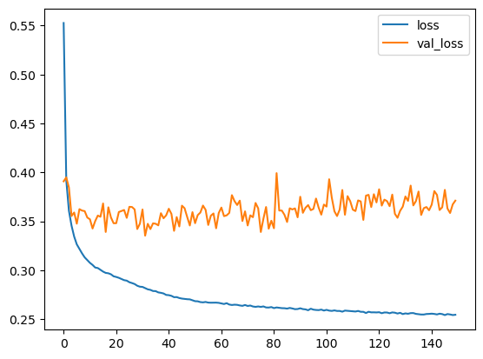
Taining
We have trained the data using ANN algorithm
Parameters :Activation layer 1 ( units = 10 activation= "relu")
Activation layer 2 ( units = 10 activation= "relu")
epochs=150
Insights :

Slide 8
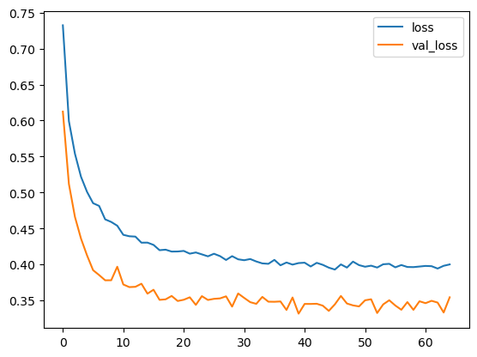
REGULARIZATION
We have used regularization techniques like DropOut an EarlyStopping in ANN algorithm
Parameters : DropOut in 1st layer = 50%
DropOut in 2st layer = 30%
callbacks= earlystop , epochs=150
Insights : After hyperparameter tuning the model is giving better results

Slide 9
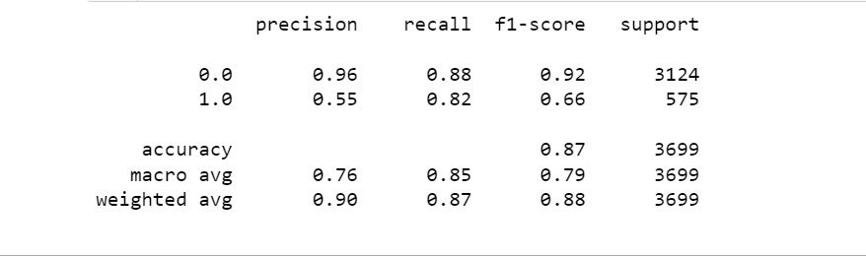
MODEL EVALUATION
We have successfully trained and predicted the model with 87% ACCURACY
Confusion Matrix
2736 | 388
105 | 470

Slide 10
THANK YOU !

